Slide 2
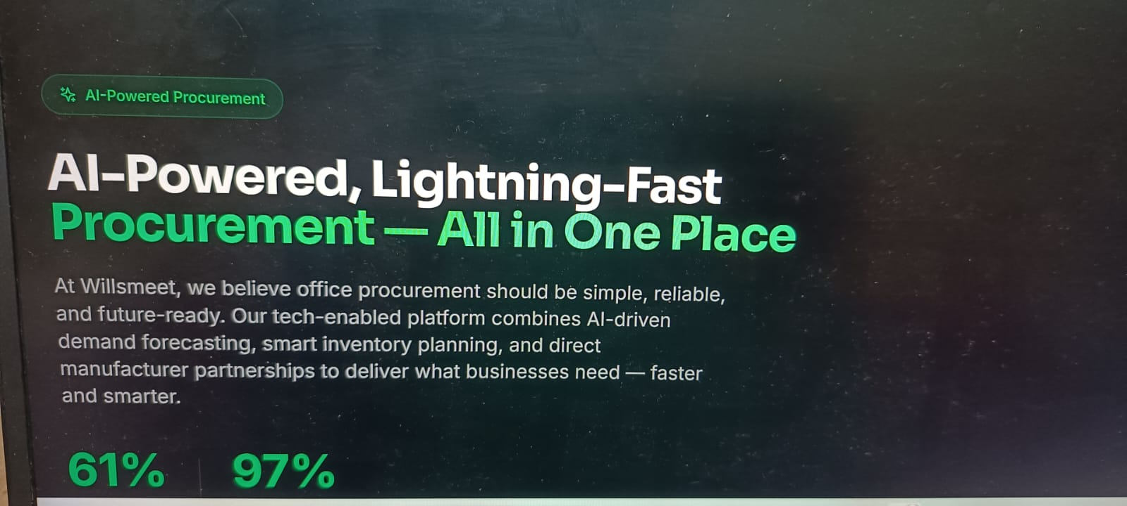
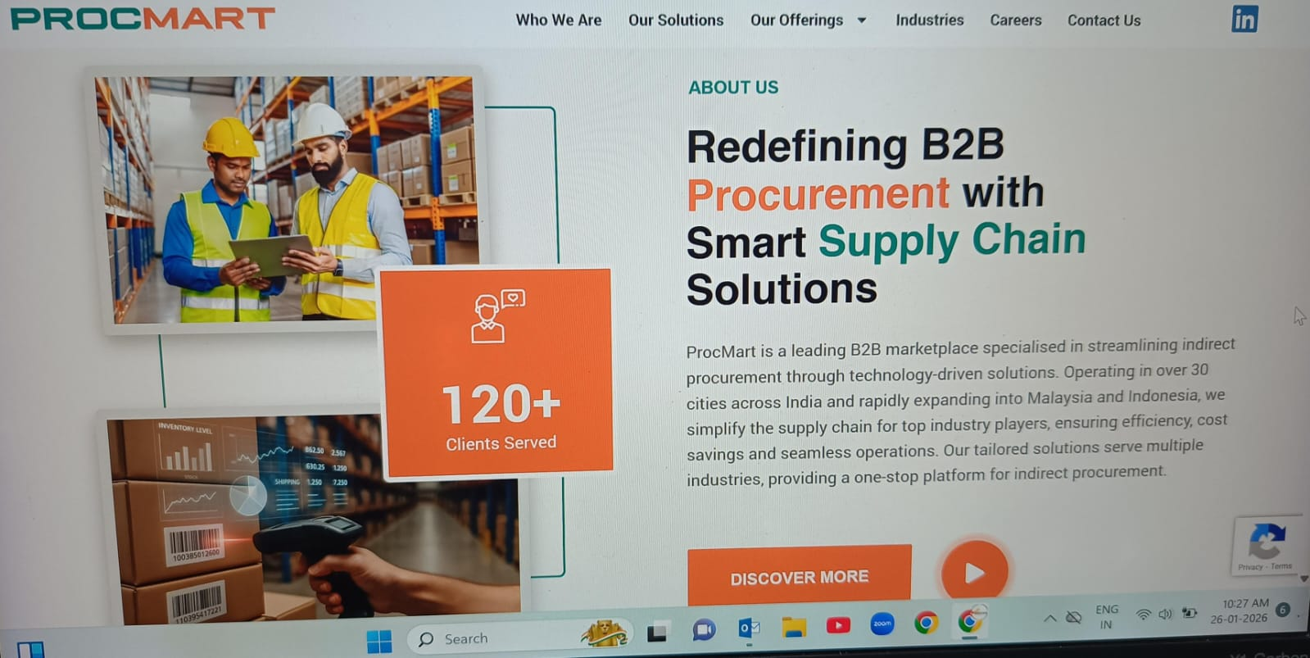
SHOW BANNER FIRST
Than show along with images

Slide 3
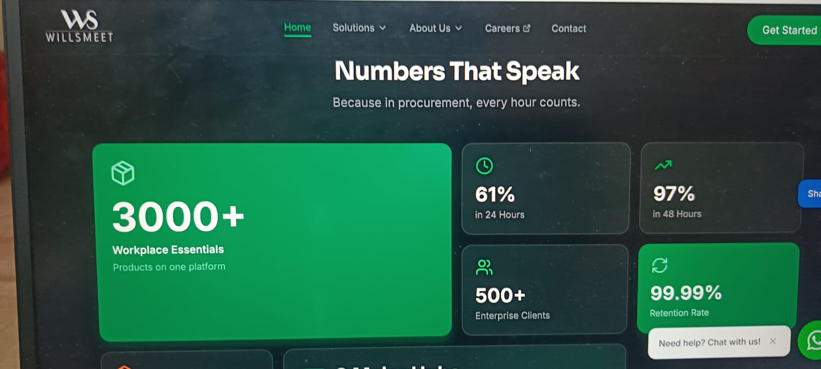
What is this , can we show it with some creativity.
Try to attach pics n show

Slide 4
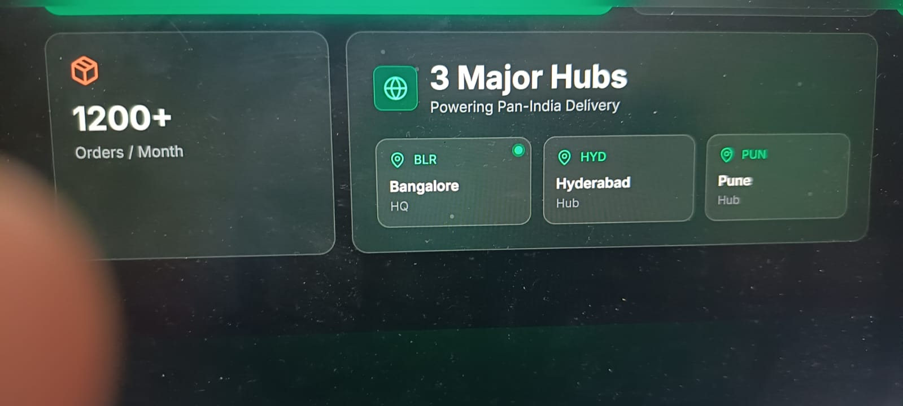

Slide 5
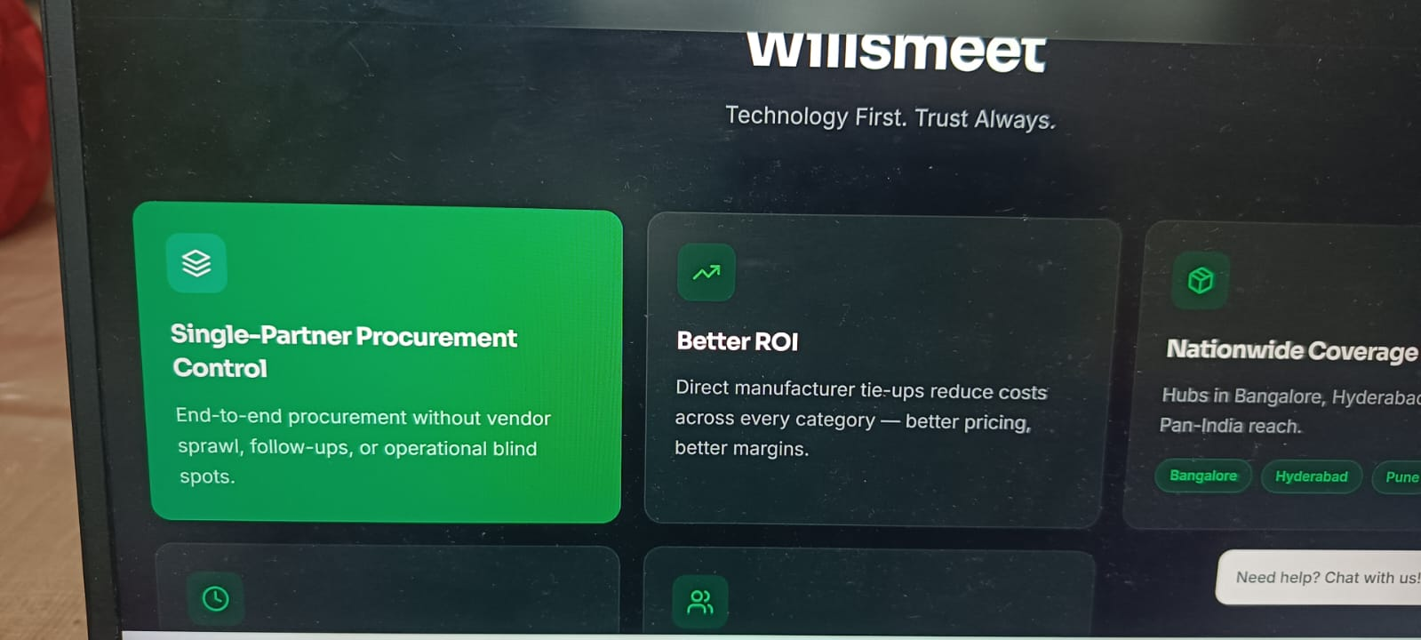
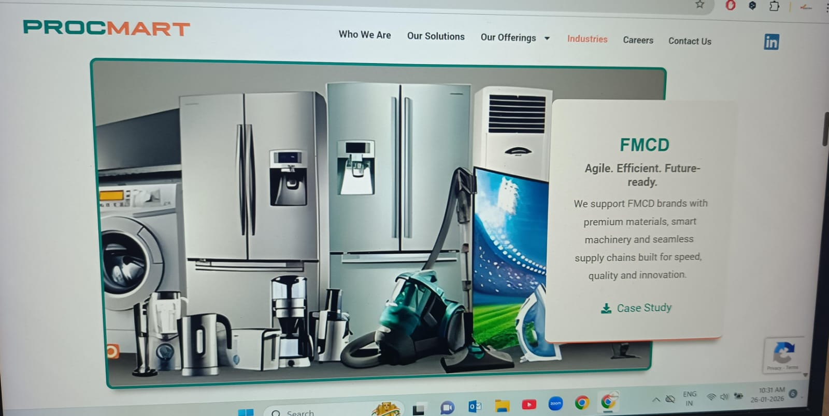
Pls show like procmart along with images

Slide 6
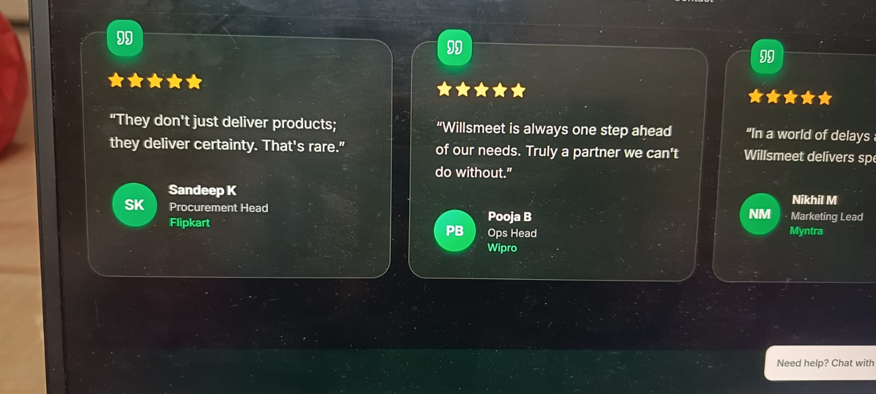
Put icon of flipkart, wipro , myntra instead of green box written as SK, PB, NM

Slide 7
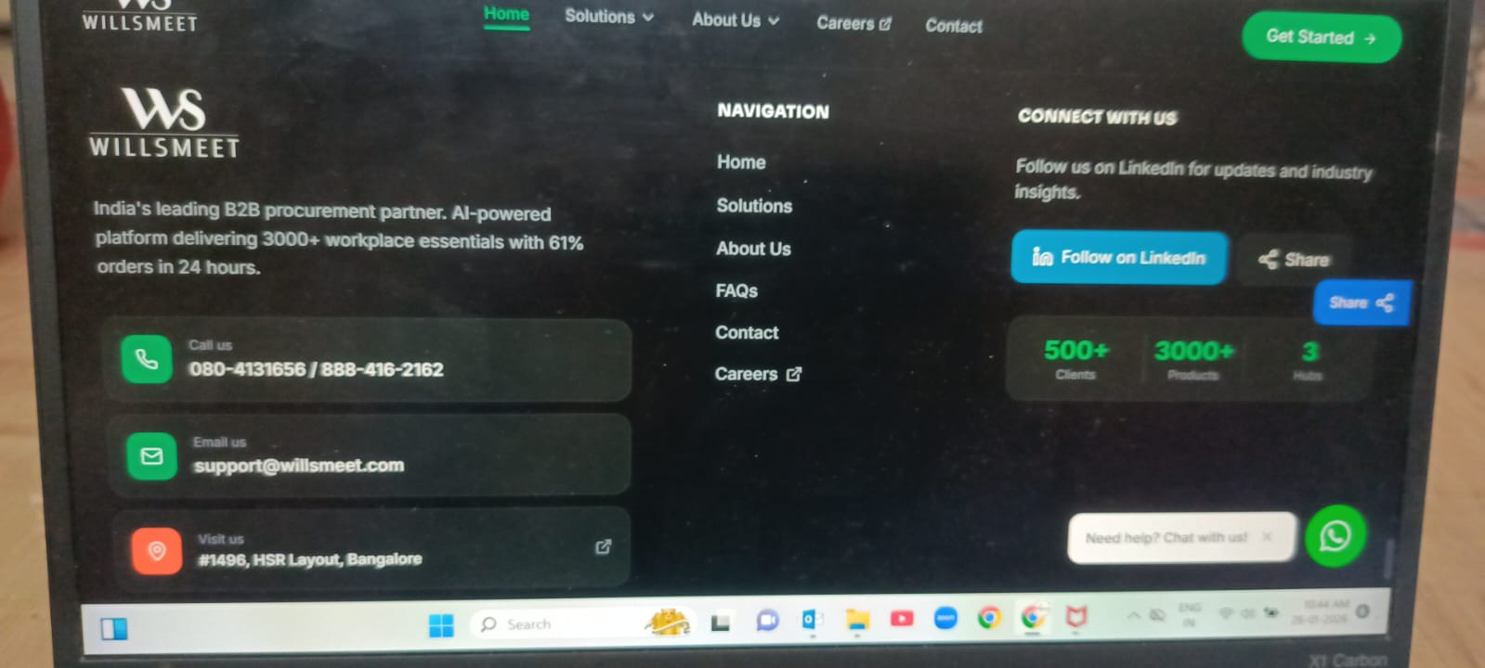
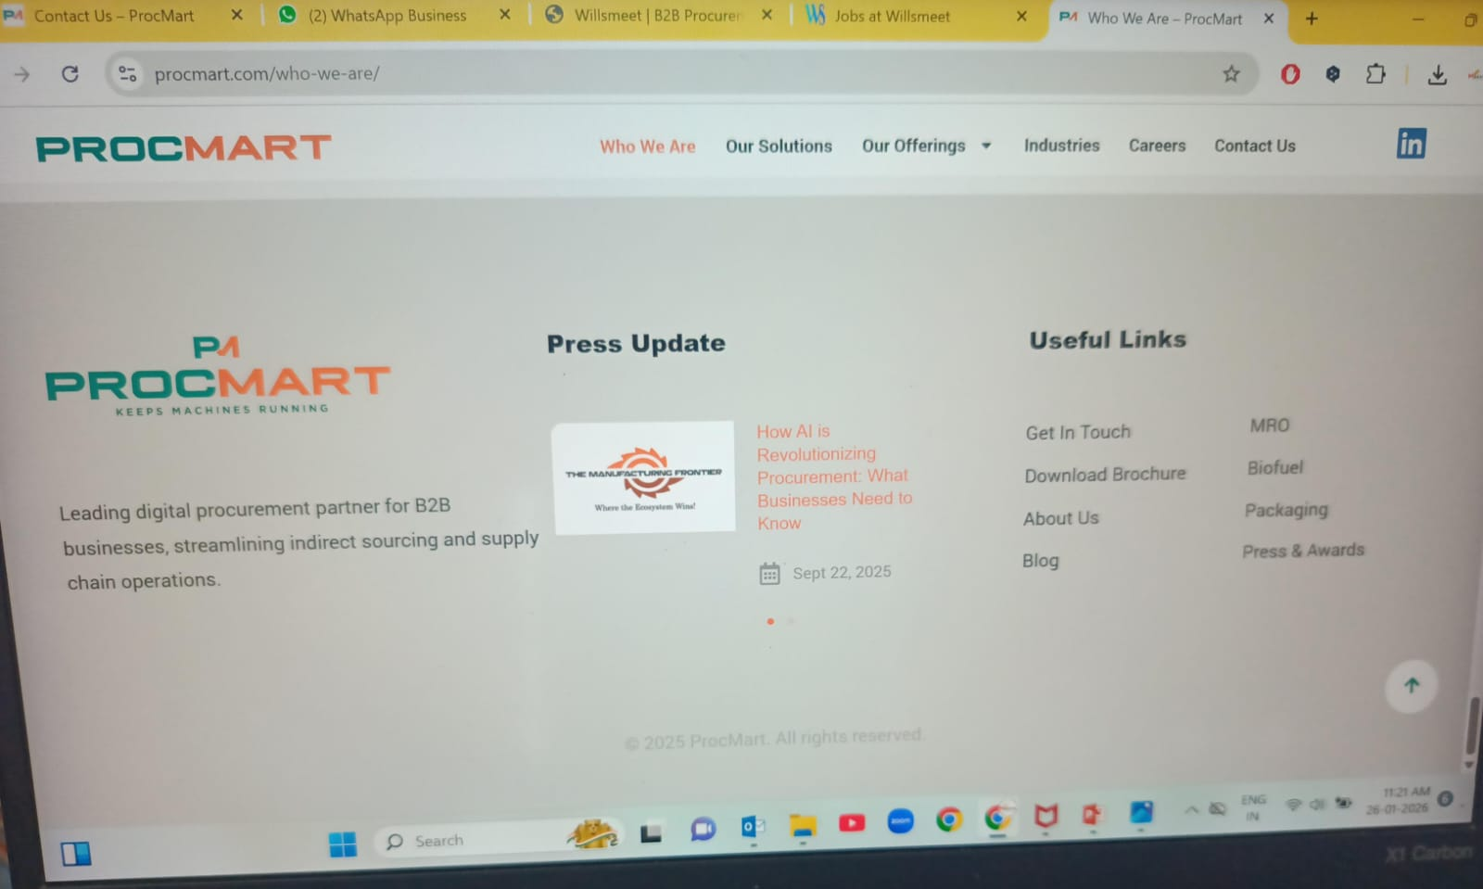
Display is too poor n unmanaged

Slide 8
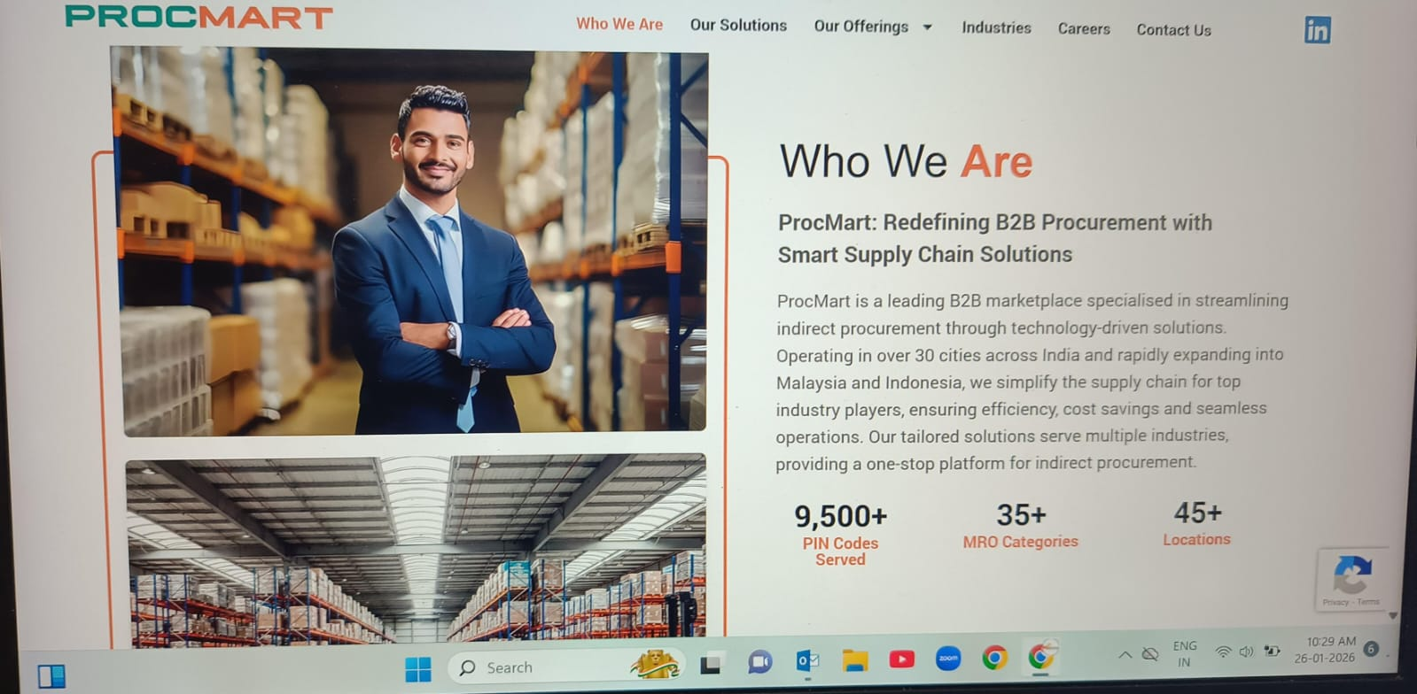
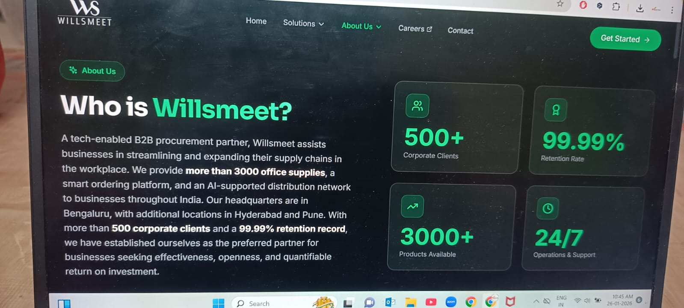
ABOUT US
Add banner first , show like procmart along with images putting creatively.

Slide 9
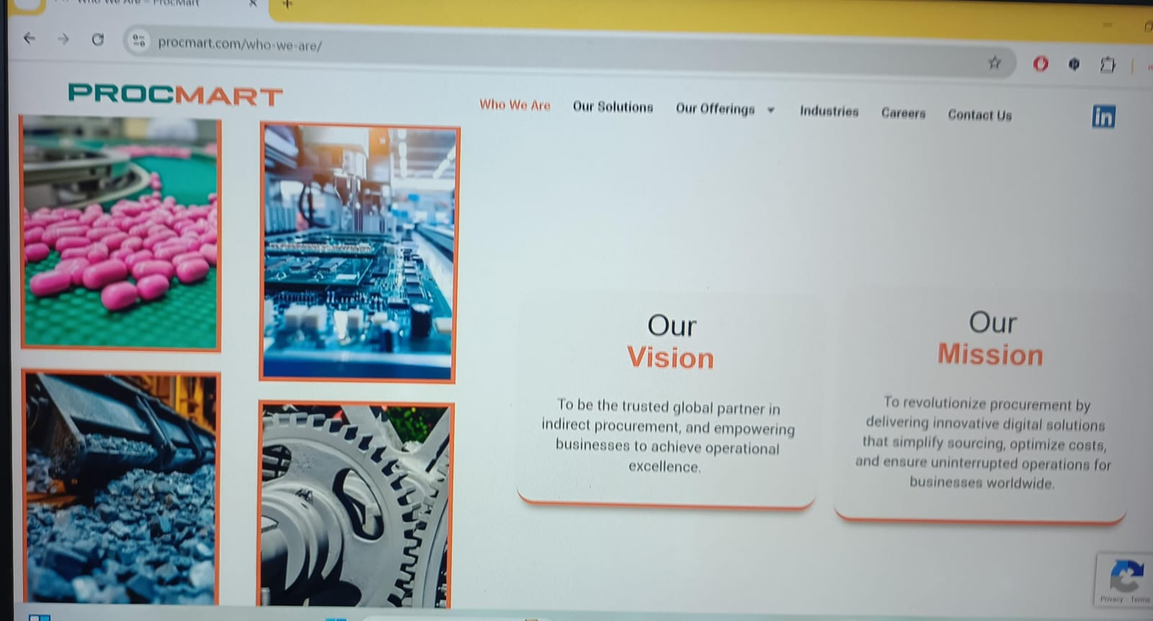
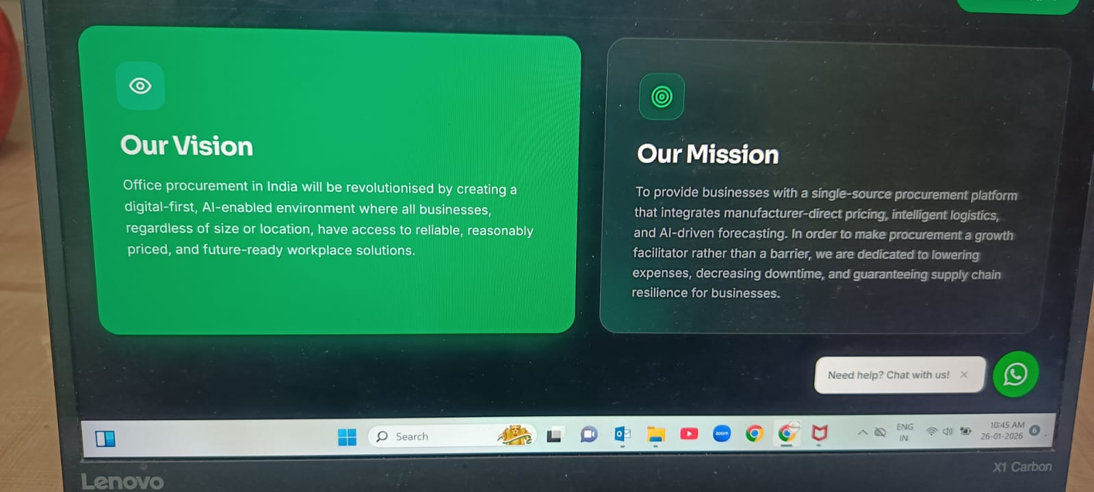
VISION MISSION
Show like procmart with 4 images continuous moving. make good highlighted borders of vision mission boxes. Bot box colour shld b same

Slide 10
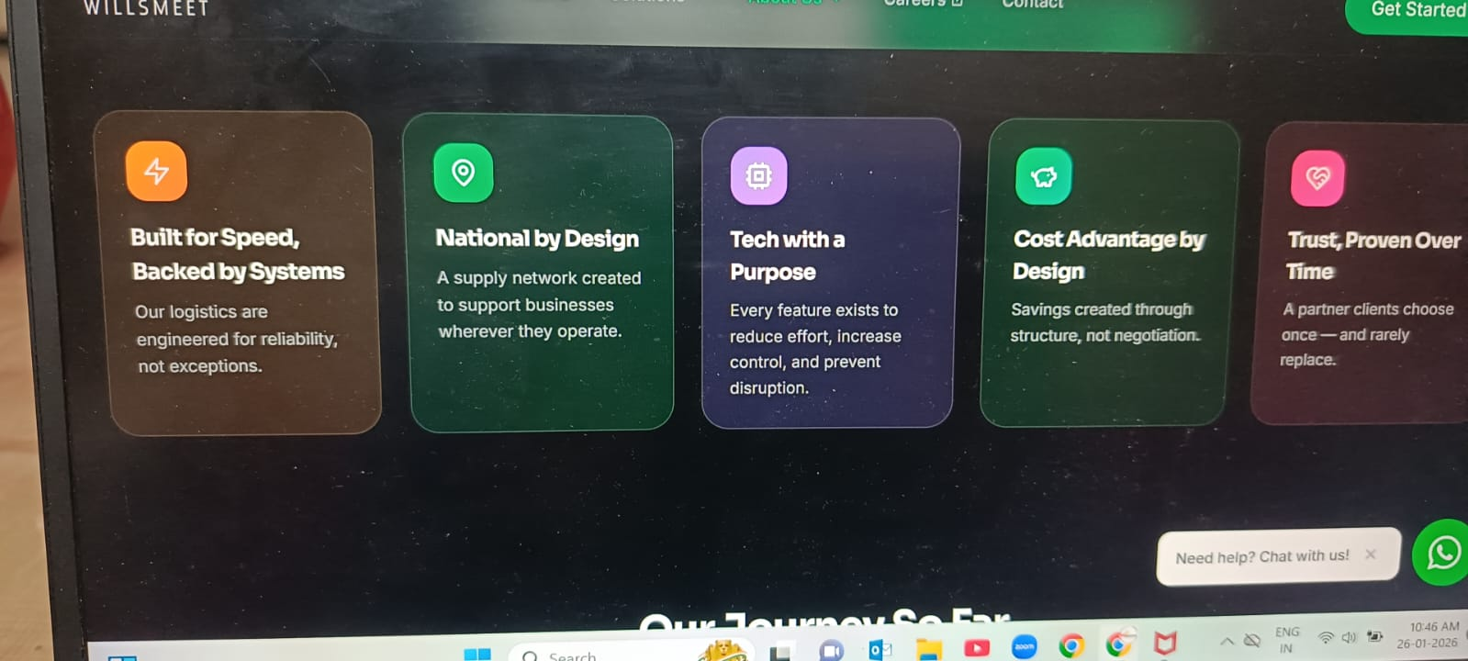
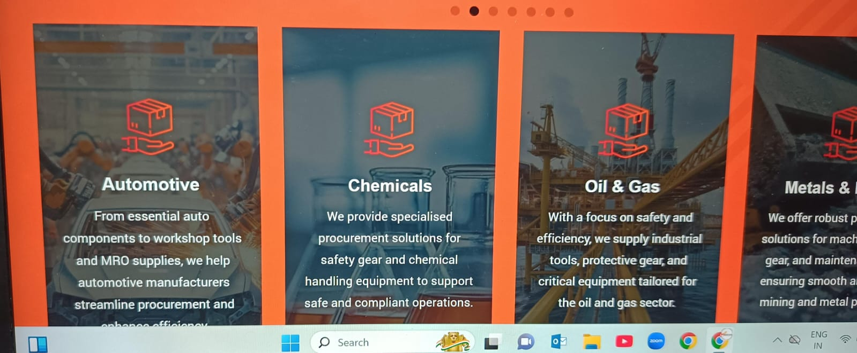
The Willsmeet Advantage
Show images at the back like procmart

Slide 11
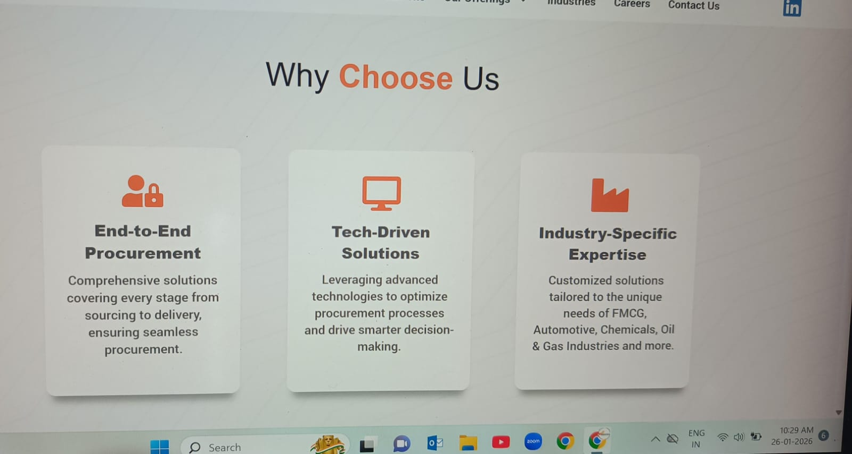
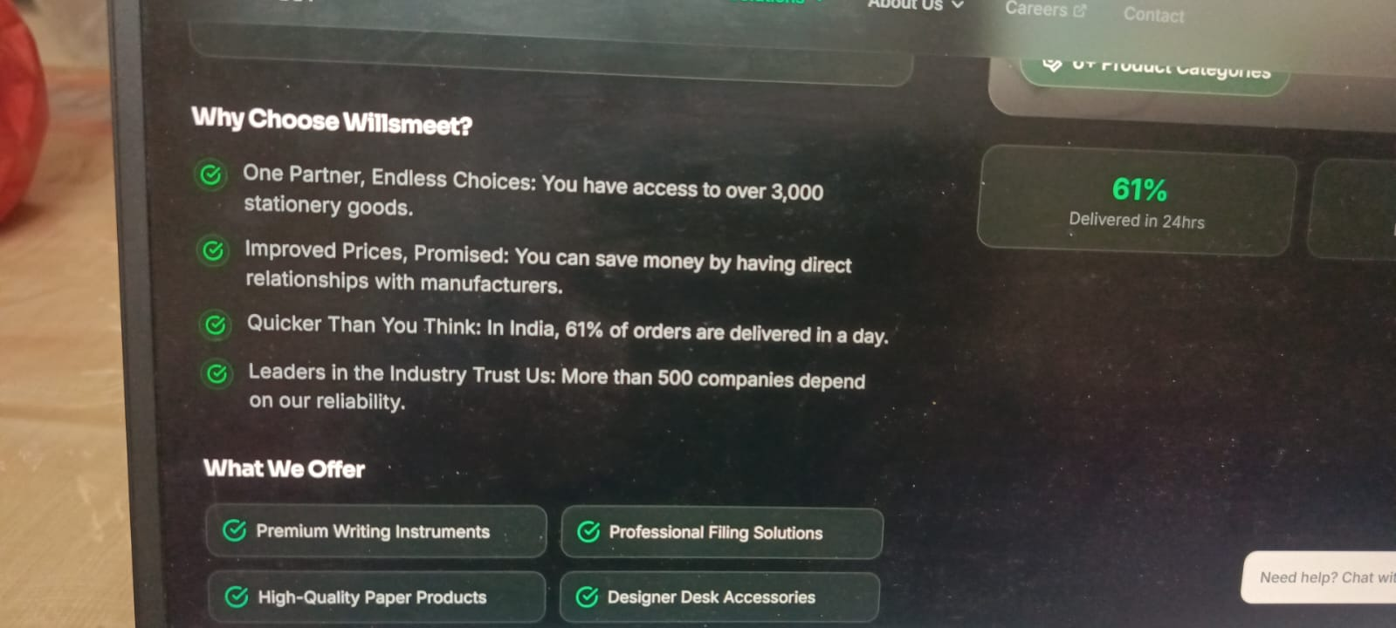
Show banner in each services Why choose (Changes should be in all services)
Pls show like procmart along with icons or with tiny images, written in boxes etc

Slide 12
Banner required in career, in contact us
FAQs - remove individual faqs for each category. Create separate tap n write there.
Abt us- more visualise n interactive.
Email - info@willsmeet.com
Add website share button on home page.
Add banners.
Check logo design n colour again.

